Slide 1

Chicago Housing Price Study
CONNOR BEREK
NISH TRIVEDI
RUI LIN

Slide 2
Chicago Housing Market
This project aims to investigate different relationships and correlations between fluctuations in the housing market, specifically in the Chicago area, and different socioeconomic factors
We will be focusing on the time period of 2011 to 2020
We will be retrieving and analyzing:
Chicago neighborhood housing prices
Housing economics (Mortgage rates, Inventories, New Listings, New Constructions)
Community factors (small business improvement, new construction, public school ratings)
Describe Chicago housing prices by neighborhoods
How does interest rate affect Chicago housing price?
Are there any positive relationships between home prices and new constructions/inventories/new listings/days on market?
Housing market vs. City spending on property development (SBIF)
Housing prices vs. Avg. Growth over School Year (Elementary)

Slide 3
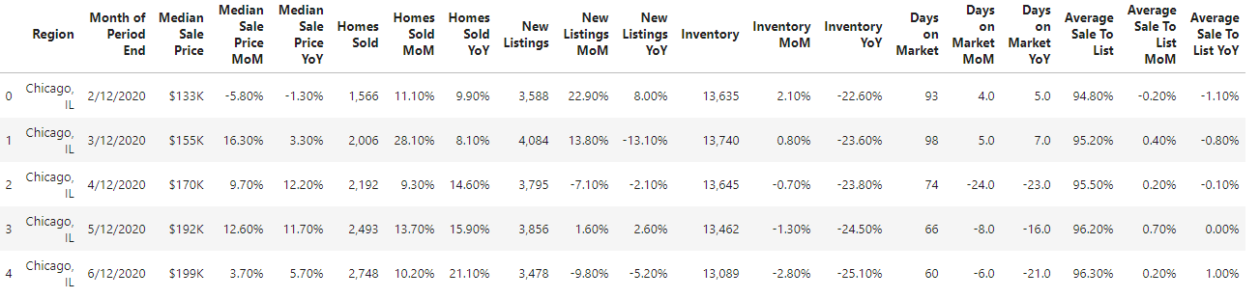
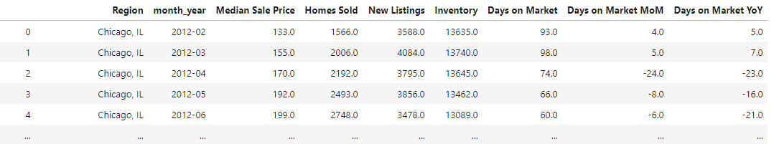
Chicago House Median Sale Price
Original DataFrame:
DataFrame after cleanup:

Slide 4
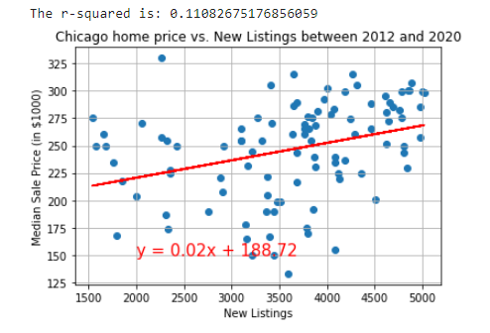
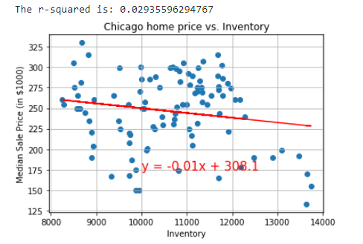
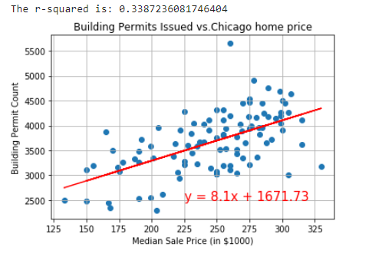
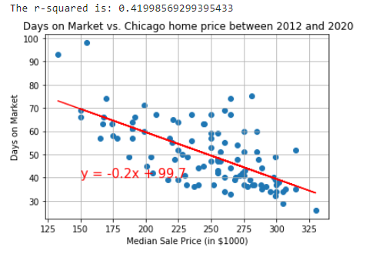
Scatter Plot on Median Home Price vs.
Building Permits /
Inventory /
New Listings /
Days on Market
Home Price vs. New Listings
No strong linear relationship between home price and new listings
Home Price vs. Inventory
No strong linear relationship between home price and inventory
Building Permits vs. Home Price
When home price goes up, more building permits are issued
Days on Market vs. Home Price
When home price goes up, day on market goes down

Slide 5
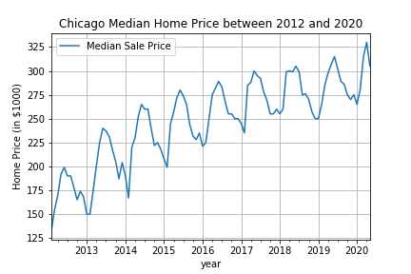
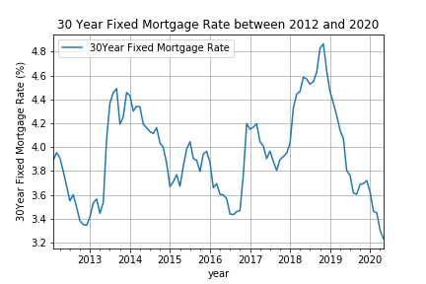
Chicago Home Price vs. Mortgage Rate
Between 2012 and 2020, Chicago home price has been going up steadily year over year with a seasonal cyclicality. The mortgage rate, however, has been volatile during this period. The rate doesn’t appear to be overly related to house price movement.

Slide 6
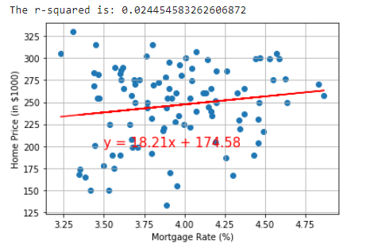
Home Price vs. Mortgage Rate
Per the r-squared, there is no strong linear relationship between mortgage rate and home price as what we expect.
It is possible that mortgage rate is not the only factor that impacts the home price in Chicago. local real estate taxes, demographic changes, etc can also impact the housing market significantly.

Slide 7
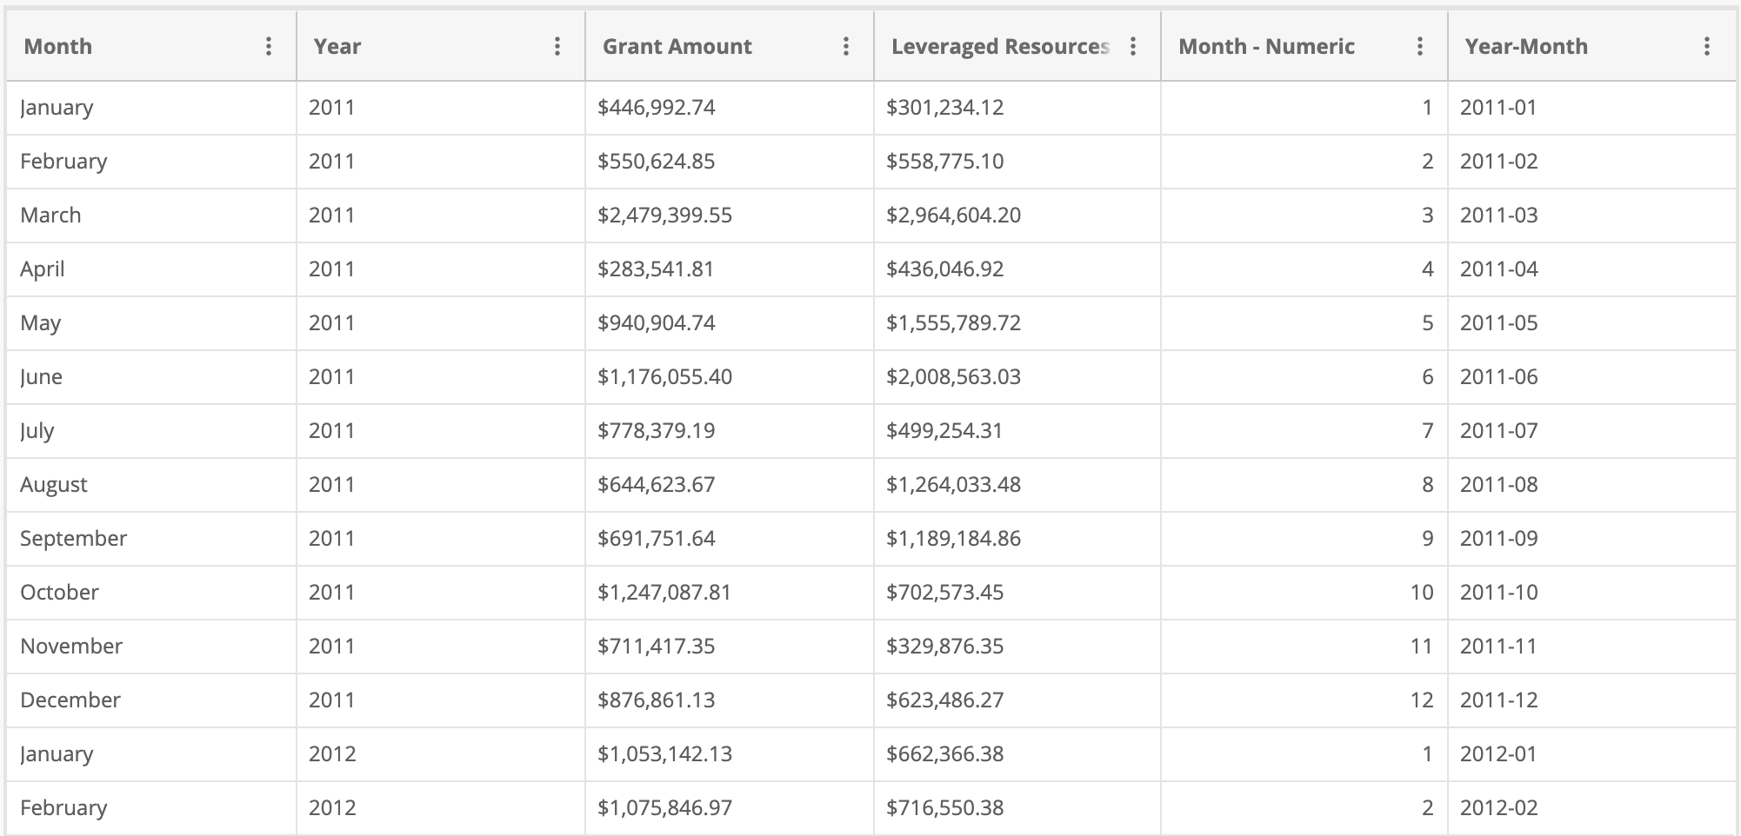
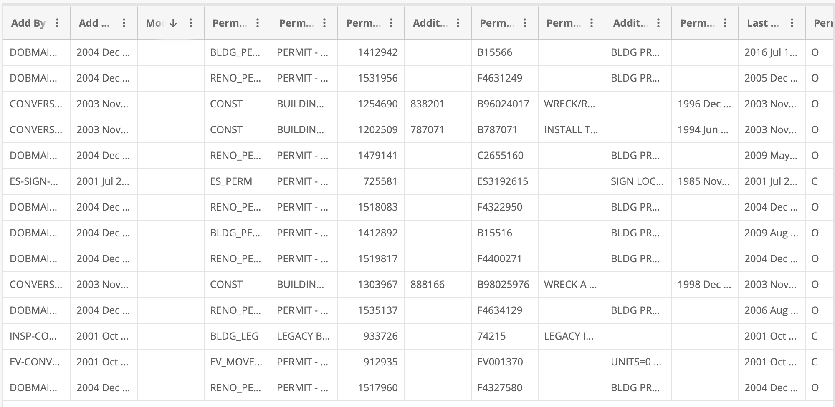
SBIF and MMRP Data
Data retrieved from data.cityofchicago.org
Data for SBIF, MMRP, Building Permits Allocated, Chicago Housing Data
Cleaned using combination of pandas and Macros
Core Analysis:
Are programs put in place by the City of Chicago for commercial/residential property development true catalysts of growth? Can trends or similarities in patterns be seen in the pertinent datasets?
Notes:
Explanation of Programs:
SBIF: financial subsidies to improvements on houses for: Facade repair and replacement, permanent interior renovations and build out, plumbing/electrical, improvements to accommodate disabled patrons or workers, purchase of adjacent property for building expansion or parking, project-related design and construction fees
Data cleanup: sbif from 2011-2019, mmrp data was from 1983 to 2020 (vba), 2011-2019 was overlap, splitting months and data and averaging total grant $$ and avg. number of permits per year

Slide 8
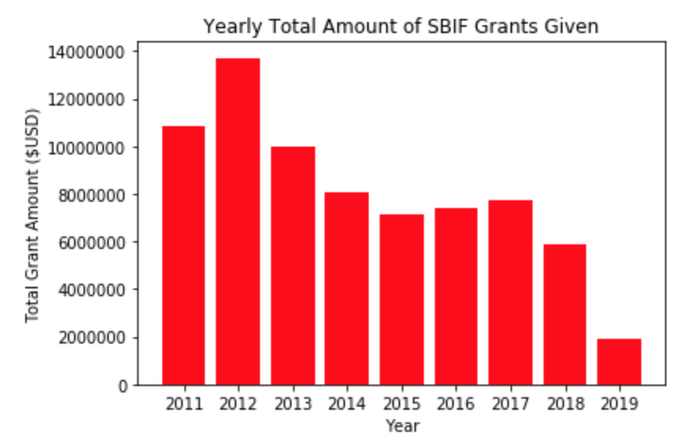
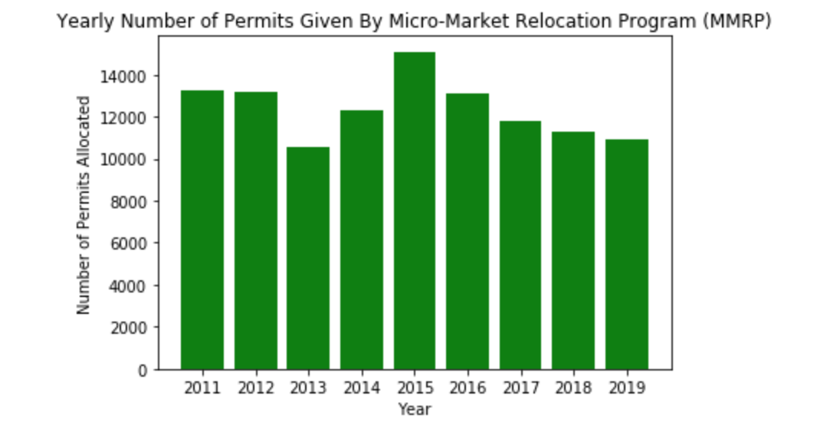
Chicago’s SBIF and MMRP Programs
Small Business Improvement Fund (SBIF) Grant
Financial subsidies to landlords for improvements to both commercial and residential properties
Grants cover 75% of cost of total plan and can range from 50-150K
Micro-Market Recovery Program (MMRP)
“The City provides $15,000 in down payment assistance to eligible owner-occupants ready to buy a home in an MMRP area”
Loans to help current owner-occupants make home repairs in MMRP areas
Notes:
Explanation of Programs:
SBIF: financial subsidies to improvements on houses for: Facade repair and replacement, permanent interior renovations and build out, plumbing/electrical, improvements to accommodate disabled patrons or workers, purchase of adjacent property for building expansion or parking, project-related design and construction fees
Data cleanup: sbif from 2011-2019, mmrp data was from 1983 to 2020 (vba), 2011-2019 was overlap, splitting months and data and averaging total grant $$ and avg. number of permits per year

Slide 9
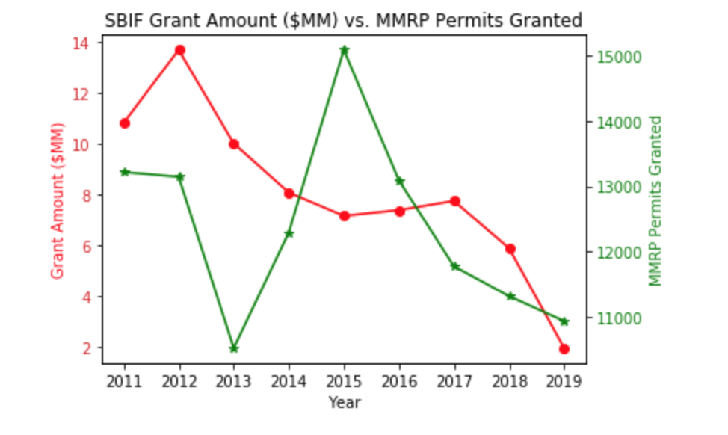
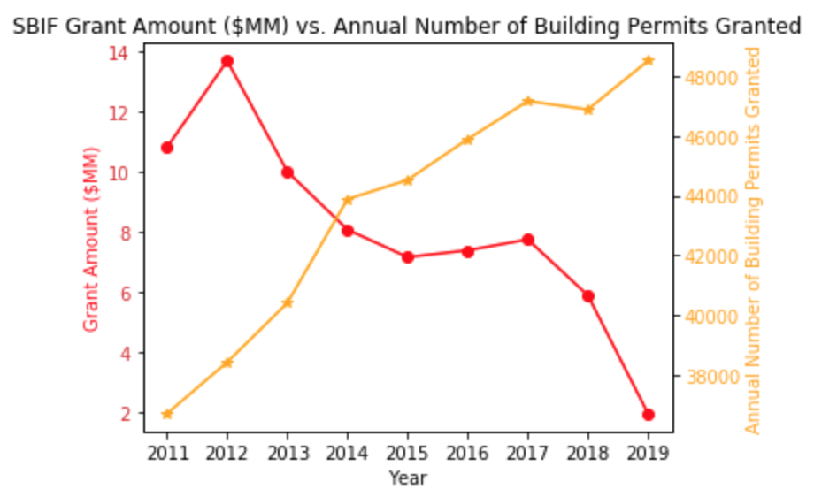
Trend Analysis
SBIF and MMRP from 2011-2019
Between 2013-2017, average SBIF grant money/year decreased while # of MMRP permits saw the greatest increase
SBIF Grant Amount and Building Permits Granted
While SBIF Grant Amounts from 2012-2019 essentially had a downwards trend, the annual number of building permits granted by the city of Chicago increased over this time
Notes:
-trends not too similar between homeowner subsidies (MMRP) and landlords seeking to improve their property (SBIF), expected
-building permits showed consistent increase while grant amounts didn’t, could mean that more buildings were built but the need for improving on existing structures has decreased?
Potential shortcomings: SBIF number of grants could have increased but avg. amt decreased

Slide 10
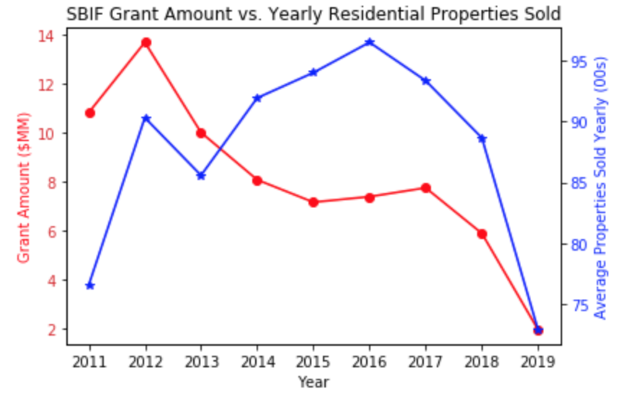
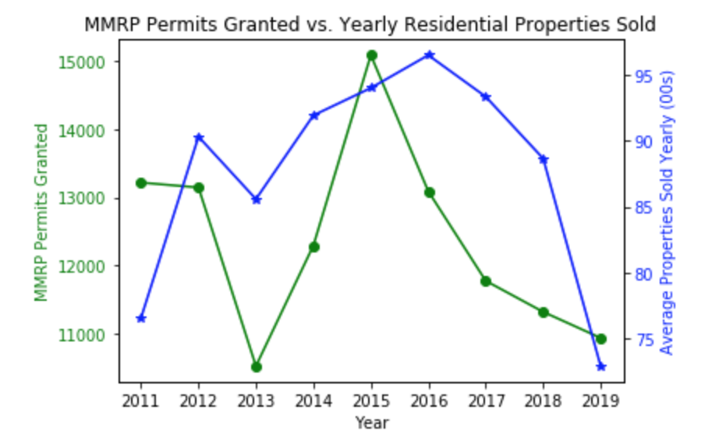
Trend Analysis
SBIF and Yearly Res. Properties Sold
Both showed similar trends between 2011-2013
From 2013-2016, less SBIF grants were allocated but avg. yearly properties (in Chicago) sold per year grew at the highest rate
MMRP Permits and Yearly Res. Properties Sold
Highest number of MMRP permits granted in the same time period (2013-2015) when residential property sales also had an upwards trend
From ~2015/2016 onwards, both the number of MMRP grants allocated and residential properties sold were downwards trending
Notes:
Graph 1: Spike in 2012 improvements could have potentially stimulated growth in the following year
Graph 2: 2013-2015 Chicago housing market was growing,

Slide 11
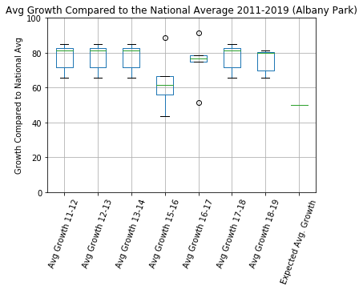
Does Elementary School Performance Have an Effect on Median Housing Price?
The idea: School performance is a very strong factor when it comes to purchasing a new home, so does it have an effect on the average housing price of a neighborhood in Chicago for a given year?
Shows the growth of every public elementary school in Albany Park and their performance year over year compared to national average.

Slide 12
Housing & School Performance
Analyzed Chicago public school records for every elementary school in Chicago from 2011-2019 (excluding the 2014-2015 school year) and focuses on two measurements that I then combined: Reading Growth over the year and Math Growth over the year. This data, once combined served as the y-axis for scatter plotting.
I took the median housing price for each neighborhood per year. Once it was cleaned, the median housing price in every neighborhood for a given year served as the x-axis.
Expected outcome: If correct, there should be a direct relationship between school performance and the median house price of that neighborhood in the given year.

Slide 13
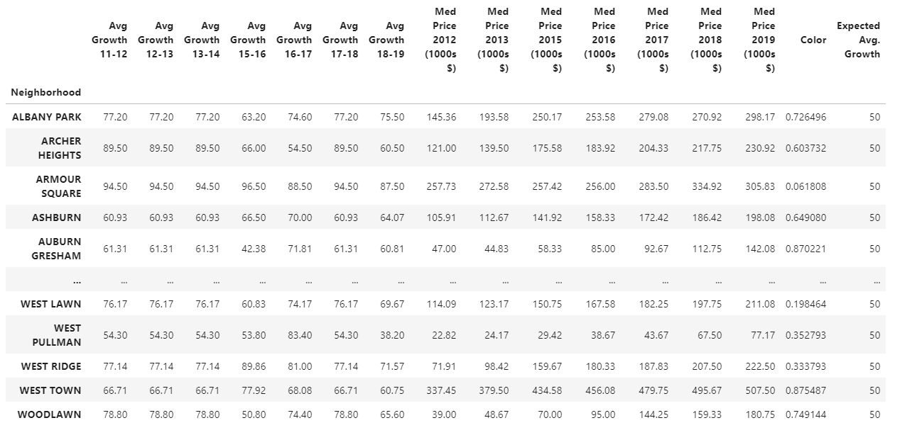
Dataframe:

Slide 14
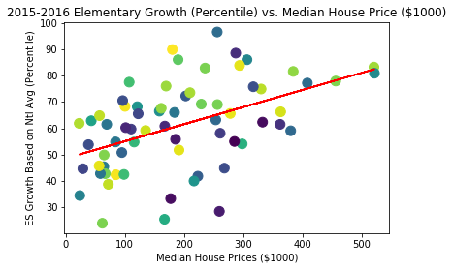
Trend Analysis
Slope: y = 0.06x + 48.57
R-squared: 0.2313901390329314
Correlation: 0.48
Chi- Squared: Statistic = 528.93, p-value = 1.98 e -73
Graph: Scatter plot of Median Housing Price(2015-2016) of each neighborhood compared to average growth for every school in a given neighborhood.
Intuition: As housing prices increase, elementary school growth against the national average increases, as well.
Based on the results of the scatter plots, we can see that there is no real trend seen between the median housing price and school performance.

Slide 15
Data Sources
Chicago Home Price between 2012 and 2020: https://www.redfin.com/blog/data-center/
Chicago Building Permits between 2006 and 2020:https://data.cityofchicago.org/Buildings/Building-Permits/ydr8-5enu
30 Year Fixed Mortgage Rate: https://fred.stlouisfed.org/graph/?g=NUh
Chicago - Small Business Improvement Fund (SBIF): https://www.chicago.gov/city/en/depts/dcd/supp_info/small_business_improvementfundsbif.html
Chicago Micro-Market Recovery Program: https://data.cityofchicago.org/Community-Economic-Development/Micro-Market-Recovery-Program-Permits/4dpw-9rts
Chicago Public School Progress Reports & School Locations 2011-2019: https://data.cityofchicago.org/browse?category=Education

